Slide 1


Using GPUs for Real time Prediction of Optical Forces on Microsphere Ensembles
Sujal Bista
Sagar Chowdhury
Satyandra K. Gupta
Amitabh Varshney
Graphics and Visual Informatics Laboratory
University of Maryland
Notes:
Welcome everyone. My name is Sujal. I am a graduate student in UMD computer science.
This paper “Using ….” is a collaboration between CS and Mechanical Engineering.
Dr. Varshney and I are from CS. Sagar and Dr. Gupta are from ME.

Slide 2
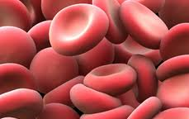


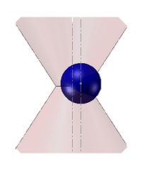
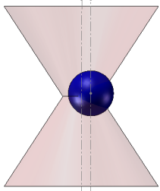
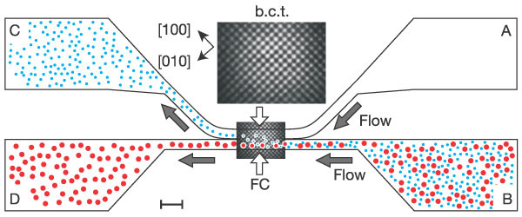
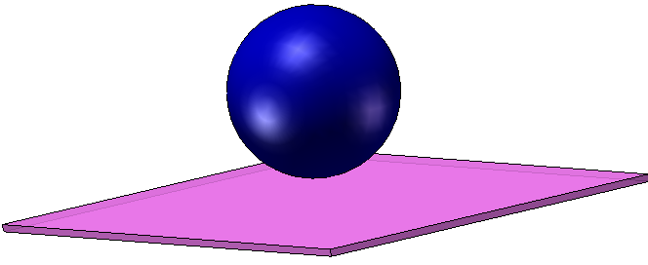
Introduction
Optical Tweezers System introduced in 1986 Ashkin at Bell laboratory
Image courtesy: saypeople.com
http://ukhumanrightsblog.com
wallpaper1213.blogspot.com
Manipulation of Red Blood Cells
DNA manipulation
Bacteria manipulation
(Suresh et al., Acta. Biomater., 05)
(Wang et al., Biophys. J., 97)
(Block et al., Nature., 89)
Manipulation of single Myosin molecule
Cell sorting
(Finer et al., Nature, 94)
(MacDonald et al., Nature, 2003)
Notes:
Optical tweezers system was first introduced by Arthur Ashkin in 1986.
It uses light to manipulate micron-sized particles.
It is widely used by scientist to manipulate and study microparticles such as dielectric spheres, cells, DNA, bacteria, and virus.
They are often used in creating assembly of micro- and nano-scaled components to make a functional device due to the extensive range of positioning and orienting capabilities of the system.
Optical tweezers is used extensively in biology
Here are few applications
Stretching RBC – show that the parasite-invaded cell loses its ability to stretch
Stretching DNA –
Rotating bacteria cell - apply OT to rotate the cell and measure its elastic properties
Stretching Myosin molecule – measure force by using feedback enhanced OT. Beads on actin filament. Record interaction of single myosin and actin flilament.
Cell sorting – Sort out different type of cell based on size and refractive index by using optical tweezers.

Slide 3
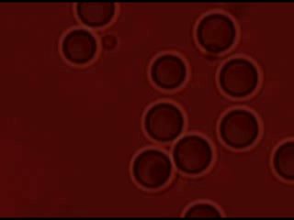
Optical Tweezers
Use laser to manipulate
Brownian motion affect micro particles
The trapped particle is steered by the laser beam
Glass plate
Fluidic medium
Laser
Trapped particle
Assembly Cell
Lens
Notes:
OT system uses a powerful laser to manipulate micro particles.
OT system is studied by performing simulations.
Force simulation is very computationally intensive due to the Brownian motion of fluid, interacting particles, Ray-particle interactions and very small time steps requirement
The random Brownian motion adds stochasticity and noise to the measurements.
The Brownian motion of suspended microparticles requires simulation fidelity finer than 10^6, which demands an enormous amount of computation.

Slide 4
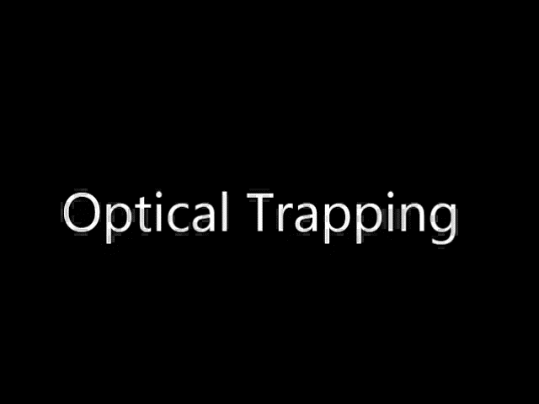
Optical Trapping
Non-contact micro and nano-manipulation technique
Gaussian intensity profile of laser beam
Incoming laser beam
Focusing Lens
Ray 2
Ray 1
F₂
n₁ > n₂
Glass sphere with refractive index of n₁
F₁
F_{n} = F₁ + F₂
F₁: Force due to ray 1
F₂: Force due to ray 2
F_{n}: Resultant force due to ray 1 and 2
Fluidic medium with refractive index of n₂
C
As a result of optical forces glass sphere moves towards focal point C
Notes:
Heart of OTS is OT which is
Non-contact force by using laser
Light bends as it passes though
This exerts equal and opposite force to the particle
Moves particle toward the focal point

Slide 5
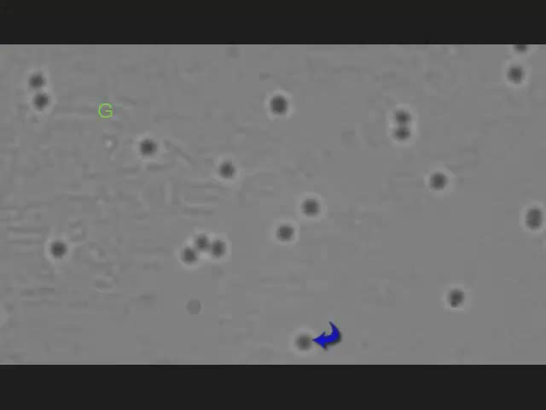
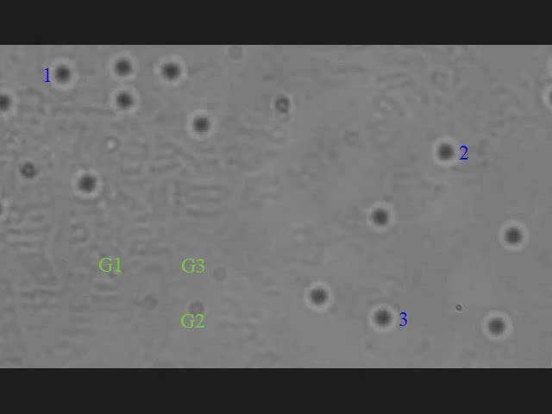
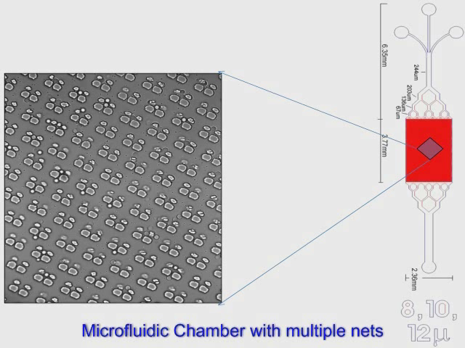
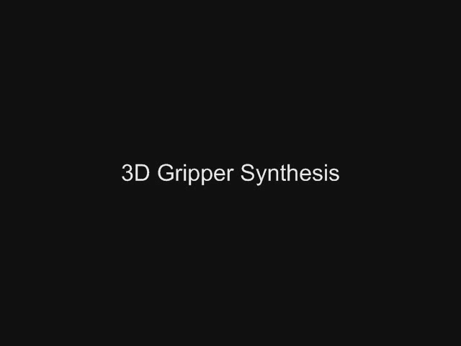
Automated Optical Manipulation
Research at University of Maryland
Single particle transport
Multiple particle transport
(Banerjee et al., IEEE Trans. Automat. Sci. Eng., 2010)
(Banerjee et al., IEEE Trans. Automat. Sci. Eng., 2012)
Optical tweezers assisted microfluidic cleaning
Indirect automated manipulation
(Chowdhury et al., ICRA, 2012, IEEE CASE 2012)
(Chowdhury et al., ASME IDETC, 2011)
Notes:
In robotics lab in Maryland, we use optical tweezers for various applications
Single particle transport - automated micromanipulation using gripper formations + path planning for collision-free transport
Multiple particle transport – multiple particle in parallel
Micro fluid cleaning - micronets are used to capture cells. It traps both wanted and unwanted cells. OT to clean in parallel
Indirect automated manipulation of a cell by using a gripper. Here cells are translated and rotated.

Slide 6
Motivation
Precise microparticles manipulation requires accurate force estimation
Closely placed particles experience secondary forces (shadowing phenomenon)
  Reflection and refraction
  Observed in optical binding where multiple trapped particles interact and form distinct and reproducible bound structures
  Affects trapping
  Studying this phenomenon is vital for scientists
Notes:
For precise microparticles manipulation, the force exerted by the laser beam has to be known.
The force exerted is estimated by performing simulations.
When microparticles are closely placed under several laser beams, the rays get reflected and refracted, which introduces secondary forces that affect the trapping.
This behavior is often referred to as the shadowing phenomenon.
The shadowing phenomenon occasionally causes trapped microparticles to escape or cause an unwanted microparticle to jump into the trap.

Slide 7
Challenges
Simulation is very computationally intensive
  Brownian motion in fluid
  Interacting particles
  Ray-particle interactions
  Very small time steps

Slide 8
Objective
To create a computer application to calculate the force exerted by the laser beams on the microparticles quickly to study the shadowing phenomenon
Notes:
We want to create an optimized application that uses GPU-based ray tracing to calculate the force exerted by the laser beams on the microparticles to study the shadowing phenomenon.

Slide 9
Contributions
High performance tool for Optical tweezers simulation
Force calculation using ray tracing and non-negative matrix factorization to study shadowing phenomenon
Calibration and validation
Notes:
We want to create an optimized application that uses GPU-based ray tracing to calculate the force exerted by the laser beams on the microparticles to study the shadowing phenomenon.

Slide 10
Related Work
Ashkin introduced ray-optic model for optical tweezers system
Banerjee et al. introduced a framework where offline simulation is used to pre-compute force
Zhou et al. introduced a force calculating model that uses ray tracing
Sraj et al. used dynamic ray tracing to induce optical force on the surface of the deformable cell
Bianchi and Leonardo used GPUs to perform optical manipulation using holograms in real-time
  Ashkin, A., 1992. “Forces of a single-beam gradient laser trap on a dielectric sphere in the ray optics regime”. Biophysical Journal, 61, Feb., pp. 569–582.
  Banerjee, A. G., Balijepalli, A., Gupta, S. K., and LeBrun, T. W., 2009. “Generating Simplified Trapping Probability Models From Simulation of Optical Tweezers System”.Journal of Computing and Information Science in Engineering, 9, p. 021003.
  Zhou, J.-H., Ren, H.-L., Cai, J., and Li, Y.-M., 2008. “Raytracing methodology: application of spatial analytic geometry in the ray-optic model of optical tweezers”. Applied Optics, 47.
  Sraj, I., Szatmary, A. C., Marr, D. W. M., and Eggleton, C. D., 2010. “Dynamic ray tracing for modeling optical cell manipulation”. Opt. Express, 18(16), Aug, pp. 16702–16714.
  Bianchi, S., and Leonardo, R. D., 2010. “Real-time optical micro-manipulation using optimized holograms generated on the GPU”. Computer Physics Communications, 181(8), pp. 1444–1448.
Notes:
Here are a few related studies. The full list can be viewed in the paper.
Ashkin showed how to use a geometric ray-optic model to compute the force exerted by the laser beam.
Banerjee et al. introduced a framework where offline simulation is used to pre-compute data at discrete points and is later used to perform fast and accurate calculations of dynamic trapping probability estimates at any arbitrary point in 3D. He uses radial basis functions to compress the force calculation data.
Zhou et al. have introduced a force calculating model that uses ray tracing based on spatial analytic geometry. Our force calculation using ray-tracing was built upon their work.
Sraj et al. used dynamic ray tracing to induce optical force on the surface of a deformable cell from which they calculate stress distribution
Bianchi and Leonardo were able to compute optimized holograms at video frame rates (48HZ). They focused on finding an effective phase mask.

Slide 11
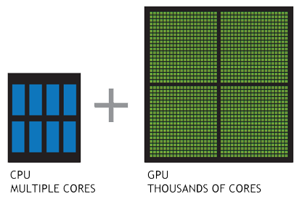
Our Approach
Hybrid CPU/GPU based
3D grid data structure
Steps
  Ray Object Intersection
  Force Calculation
    Using ray tracing
    Using Non-Negative Matrix Factorization
  Force Integration
Notes:
Based on the nature of the problem, we decided to go with a hybrid CPU + GPU based approach.
A laser beam is divided into a bundle of rays.
For each ray we compute force independently in parallel.
3D grid created in CPU
Data is sent if update is needed
Our entire pipeline is divided into three steps
Ray object intersection
Force calculation
Force Integration

Slide 12
Our Approach : Ray Object Intersection
Uses a 3D-grid based data structure
  Faster creating, updating, and ray traversing speed
  Created on the CPU
  Intersections performed on the GPU
The reflected, refracted, and transmitted rays are calculated
Notes:
A laser beam is decomposed into a bundle of rays.
For each ray, we compute ray object intersection.
3D-grid based data structure for acceleration. We chose a uniform grid-based data structure over BSP, kDTree, and Octree because this data structure is able to much more quickly perform creating, updating, and ray traversing operations.
Data structure created in CPU and updates sent to GPU as needed
For each intersection we calculate 3 rays.

Slide 13
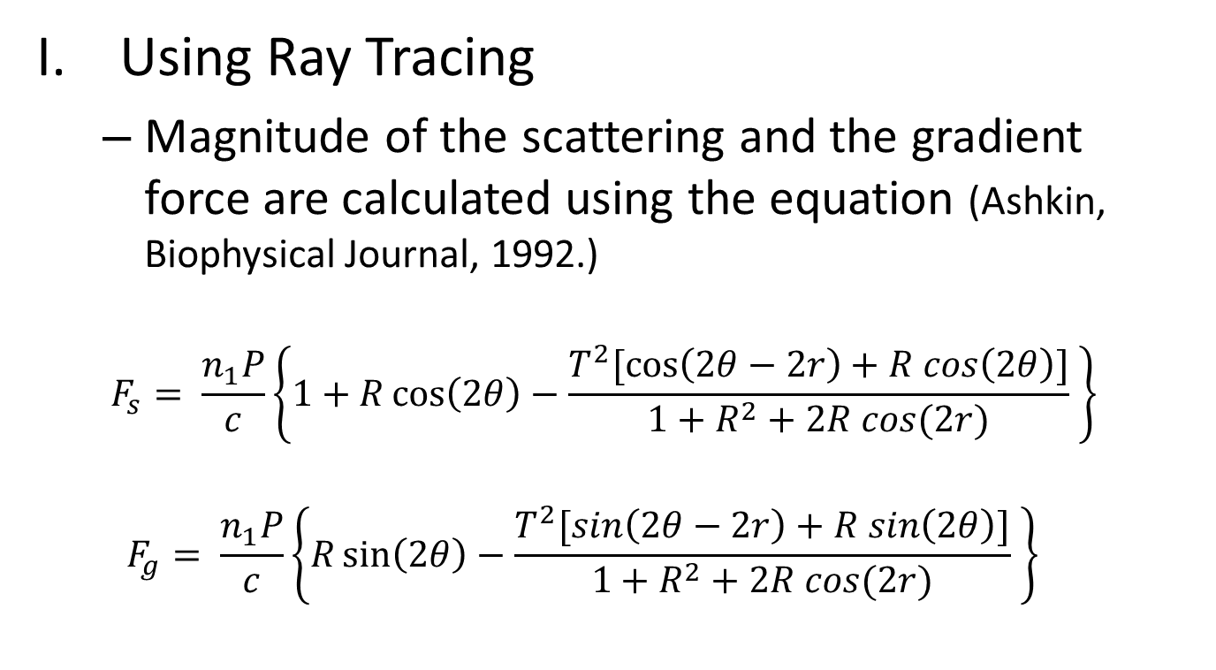
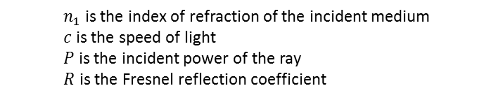
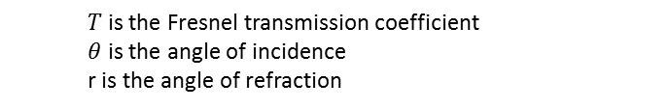
Our Approach : Force Calculation
Using Ray Tracing
  Magnitude of the scattering and the gradient force are calculated using the equation (Ashkin, Biophysical Journal, 1992.)
  $$F_{s}= \frac{n_{1}P}{c}\left\{1+R\cos\left(2θ\right)−\frac{T^{2}[\cos\left(2θ−2r\right)+R cos\left(2θ\right)]}{1+R^{2}+2R cos(2r)} \right\}$$
  $$F_{g}= \frac{n_{1}P}{c}\left\{R\sin\left(2θ\right)−\frac{T^{2}[\sin\left(2θ−2r\right)+R sin\left(2θ\right)]}{1+R^{2}+2R cos(2r)} \right\}$$
  $n_{1}$ is the index of refraction of the incident medium
  $c$ is the speed of light
  $P$ is the incident power of the ray
  $R$ is the Fresnel reflection coefficient
  $T$ is the Fresnel transmission coefficient
  $θ$ is the angle of incidence
  r is the angle of refraction
Notes:
The magnitude of the gradient and scattering force is calculated using the equation described by Ashkin. Where
n1 is the index of refraction of the incident medium
c is the speed of light
P is the incident power of the ray
R is the Fresnel reflection coefficient
T is the Fresnel transmission coefficient
theta is the angle of incidence
r is the angle of refraction
The direction of the ray is the same as the scattering direction.
For the gradient direction, we use the scattering direction’s orthogonal component that lies on the plane formed by the center of the particle, the point where the ray intersects the particle, and the intersection of the ray with the horizontal plane.

Slide 14
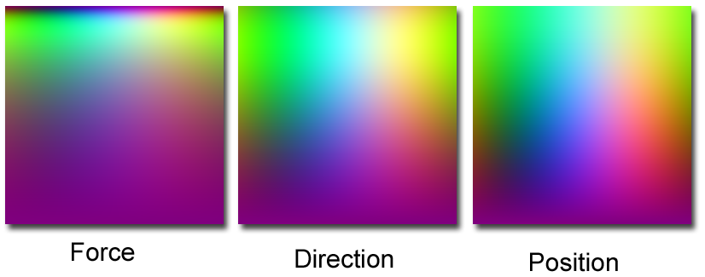



Our Approach : Force Calculation
Using Non-Negative Matrix Factorization
  Discretizing the incident angles, the force exerted, and the outgoing ray, NMF creates large look-up maps
  Takes advantage of the coherence
  Compresses lookup table using NMF
  Microparticle with an uneven density
$$n×n$$
$$n×m$$
$$θ$$
$$m ×n$$
$$∅$$
Notes:
Coherence between the input rays, the force exerted, and the transmitted rays.
Discretize the incident ray angles and compute the force exerted and the outgoing transmitted ray. We then save the output to a large look-up map that is used to directly convert the incident ray angle to the exerted force, outgoing rays position, and direction
The look-up maps are large and depends on properties of beads (such as refractive index).
So we use Non-negative matrix factorization to factorize each mapping matrix into two compact matrices
NMF is useful when the microparticle has an uneven density, which makes the computation of the path a ray travels within the particle both difficult and computationally expensive

Slide 15
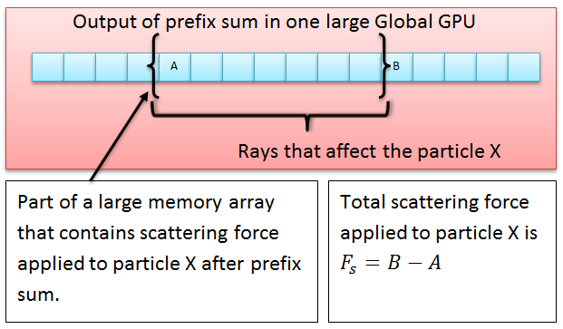
Our Approach : Force Integration
The net force is calculated by integration. (Banerjee et al., JCISE., 2009)
Integration is performed in the GPU
Components of the force are saved in groups in a large memory array
A parallel-prefix sum is performed
The final force contribution is calculated using appropriate entries from the segment boundaries
Notes:
The net force applied on each particle is calculated by performing integration of the force field over the surface of the microparticle as done by Banerjee et al.
Once we compute the force applied by each ray, we integrate the results to find the net force.
The output of the earlier steps are saved in the GPU. So we also perform the force integration step in the GPU to save time by eliminating a transfer delay.
We perform a parallel prefix sum of the large array once. Then final force contribution for each particle is calculated by subtracting appropriate entries from the segment boundaries of each component

Slide 16
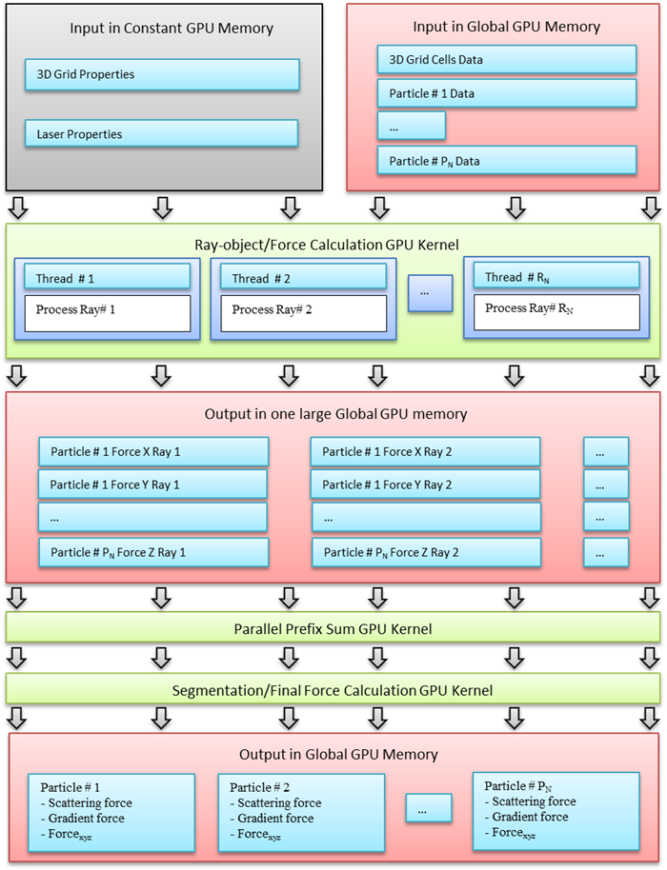
The complete GPU pipeline
Notes:
Here is the complete GPU pipeline.
Constant memory are small but faster than global memory. So we save properties of the laser and the 3D grid into the constant GPU memory. And the properties of the particles and the 3D grid cells are saved in the global GPU memory.
We then perform ray-object intersection and force per ray calculation. The output is written to a large global memory array.
Parallel-prefix sum is executed on the large global memory array.
Segmentation/Final force calculating kernel finds the proper segment boundaries for each component and subtracts necessary amount from the boundaries to compute the final result

Slide 17
Results : Precision Comparison
The comparison of precision against Ashkin’s CPU-based method computed using an equal number of rays and double precision floating-point arithmetic
  Precision is high
Method | Number of Rays
 | 8² | 16² | 32² | 64² | 128² | 256² | 512²
GPU NMF (Float) | 6.8e-3 | 4.7e-3 | 3.4e-3 | 2.8e-3 | 3.5e-3 | 2.5e-3 | 3.2e-3
CPU Ray (Double) | 1.0e-4 | 1.0e-4 | 1.0e-4 | 1.0e-4 | 1.0e-4 | 1.0e-4 | 1.0e-4
CPU Ray (Float) | 5.0e-4 | 1.0e-4 | 1.0e-4 | 1.0e-4 | 2.0e-4 | 1.0e-4 | 1.0e-4
GPU Ray (Float) | 5.0e-4 | 6.0e-4 | 5.0e-4 | 5.0e-4 | 5.0e-4 | 5.0e-4 | 5.0e-4
Notes:
Precision by computing relative error (based on LAPACK http://www.netlib.org/lapack/lug/node75.html)
Against Ashkin’s CPU-based method double precision floating-point arithmetic.
The relative error decreases as the number of rays increases.
For NMF based computation, the relative error decreases at first and then fluctuates slightly as we increase the number of rays. This is because we discretized input angles while creating the mapping table. This addition of rays while keeping the size of the mapping table constant can increase the amount of error.
When the error gets too small (<<.0001) error fluctuates due to few checks put in all of the methods to prevent floating point errors.
Floating point precision error is kept low by performing the intersection/force computations close to the origin ( zero ).

Slide 18
Results : Time Comparison
The time taken in seconds to compute the total force exerted by a laser beam on 32 interacting microparticles computed 5000 times at different positions
66 times faster than traditional Ashkin’s method
10 times faster than its CPU-based ray tracing analog
Method | Number of Rays
 | 8² | 16² | 32² | 64² | 128² | 256²
Ashkin (Float) | 1.887 | 7.77 | 31.51 | 128.13 | 515.1 | 2081.6
Ashkin (Double) | 1.797 | 7.75 | 32.09 | 129.21 | 519.8 | 2101.7
CPU Ray (Float) | 0.295 | 1.24 | 5.14 | 21.49 | 86.4 | 346.2
CPU Ray (Double) | 0.310 | 1.30 | 5.95 | 23.81 | 95.1 | 379.2
CPU Ray 3D Grid (Double) | 0.383 | 1.34 | 5.78 | 22.85 | 90.7 | 360.8
GPU NMF (Float) | 1.305 | 2.04 | 3.58 | 9.10 | 30.7 | 116.5
GPU Ray (Float) | 1.264 | 1.61 | 1.98 | 3.75 | 9.9 | 33.3
GPU Ray 3D Grid (Float) | 1.885 | 1.86 | 2.26 | 3.69 | 9.4 | 31.5
Notes:
We performed force calculations using a laser beam and 32 interacting microparticles computed 5000 times placed in different locations.
The ray tracing methods can capture the interaction of a laser with multiple particles while Ashkin’s traditional method can only capture the interaction of the laser with one particle at a time and does not take into account shadowing effects.
For the second experiment, we also show the performance difference that occurs when using a data structure while doing ray tracing.
The GPU-based force calculation that uses the grid based data structure is about a 66 times faster than Ashkin’s traditional method, and about 10 times faster than its CPU-based ray tracing analog when 256 sq rays are used to represent the laser beam.
No Grid
More intersection
Coalesced read of sphere particles
With Grid
Cost of creation grid
Transfer mesh data
Non coalesced memory access for grid
Non coalesced memory access for sphere particles reads
Multiple branches
3D-DDA algorithm
Computation is faster than memory access

Slide 19
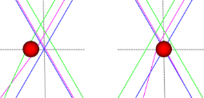
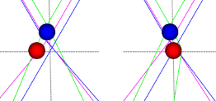
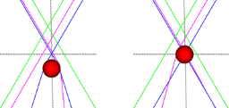
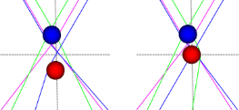
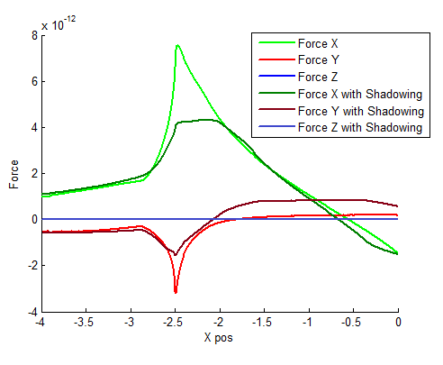
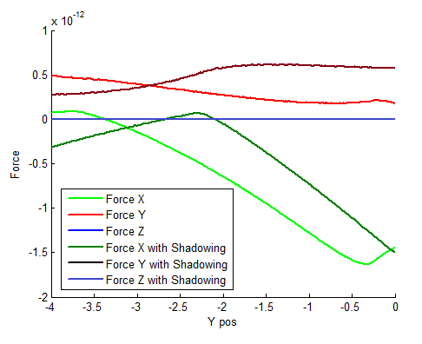
Results : Force Due to Shadowing
Three laser beams
Stationary microparticle (blue) casting shadow
Force plot of moving microparticle (red)
X-axis force plot
Y-axis force plot
Notes:
Here we show how shadowing effects significantly changes the force applied. This can change the behavior of the optical traps.
Experimentally validating the results of simulations is challenging. There is no direct way to measure force.
The force needs to be inferred from the observed motion. This requires a high speed image capture, accounting for the Brownian motion, and accounting for image blurring due to motion in the z-direction.
We are currently in the process of designing experiments to record particle trajectories in the presence and absence of shadowing phenomena.

Slide 20
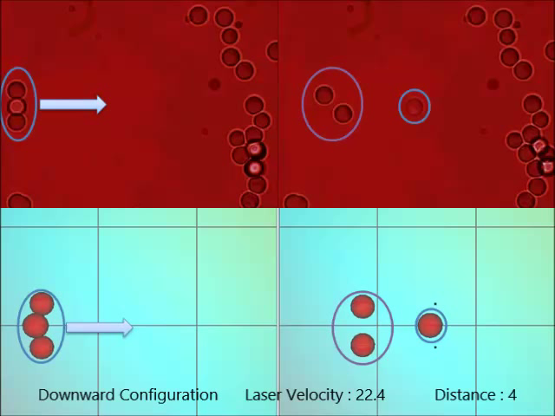

Results
Calibration and Validation
  Estimated laser power at objective lens and electrostatic force
  In the configuration with the lower beads separated by $4μm$, only the upper bead can be steered by the laser at $22.4μm/s$
+Y
Downward Configuration
+X
+Z
Laser Direction
Notes:
The system is calibrated by estimating the laser power at the objective lens by trapping a freely diffusing particle and observing its velocity as it falls into the trap.
We added a repulsive force acting upward in the positive 𝑌 direction in the simulation to model the electrostatic force from the surface that prevents the beads from falling down to the surface.
The distance of each microparticle from the bottom of the surface can vary and they can all have different charges, resulting in different amounts of repulsive force. We estimated the repulsive force based on the observed behavior.
Our simulation is able to successfully predict the breaking point for the configurations

Slide 21
Conclusion and Future Work
High performance visual computing tool
Force calculation using non-negative matrix factorization
Shadowing phenomenon
66-fold speed up
Calibration and validation
In the future:
  Compute the force on demand
  Force calculation based on ray sampling
Notes:
The GPU-based application computes the forces that are generated when laser beams interact with multiple microparticles.
When evaluating the force exerted by a laser beam on 32 interacting particles, our GPU-based application is able to get approximately a 66-fold speedup compared to the single core CPU implementation of Ashkin’s traditional approach and 10-fold speedup over its single core CPU-based counterpart.
We have developed an alternative way to calculate the force exerted by the laser that exploits the coherence of the mapping from the incident ray to the components of force and the transmitted ray by using NMF
Our program is capable of computing the forces exerted by laser beams on multiple microparticles (up to 32) at more than 100Hz, which is a higher rate than that of a typical optical device used for imaging/monitoring the microparticles.
Our program is also capable of providing visual feedback as it calculates force.
One future direction that can be taken in the research is to design ways to compute the force over a few time steps by taking account of positional changes might provide further speedup. Currently every time step is computed independently.
Another avenue that could be explored is to use sample rays to detect if the micro environment has substantially changed from the last computation. This information could be used to decide if complete new force calculation is required.

Slide 22
Future Work
Computing the force over a few time steps by taking account of changes might provide further speedup
Perform experimental validation
Notes:
Computing the force over a few time steps by taking account of changes might provide further speedup. Currently every time step is computed independently.
Perform experimental investigation to validate our computational model by performing tests on scenarios that can be validated experimentally.

Slide 23
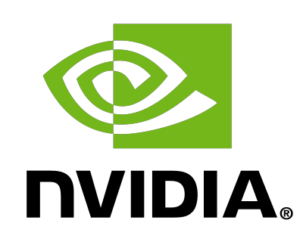

Acknowledgements
National Science Foundation: CMMI 08-35572.
NVIDIA CUDA Center of Excellence Program
Derek Juba, Cheuk Yiu Ip, Rob Patro, Icaro da Cunha, Yang Yang, Adil Yalcin, and the reviewers for refining this paper and presentation
Thank you!

Slide 24

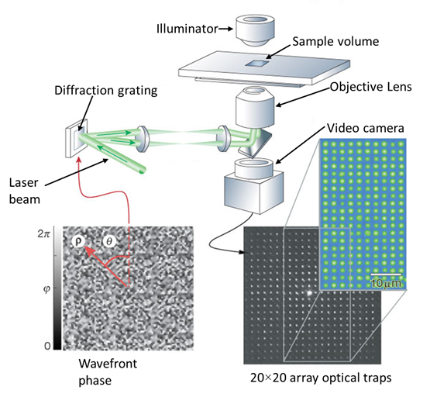
Questions
Sujal Bista
    www.cs.umd.edu/~sujal/
GVIL
  www.cs.umd.edu/gvil/
Maryland Robotic Center
  www.robotics.umd.edu

Slide 26
Gaussian intensity profile of laser beam
Incoming laser beam
Focusing Lens
Ray 2
Ray 1
F₂
n₁ > n₂
Glass sphere with refractive index of n₁
F₁
F_{n} = F₁ + F₂
F₁: Force due to ray 1
F₂: Force due to ray 2
F_{n}: Resultant force due to ray 1 and 2
Fluidic medium with refractive index of n₂
C
As a result of optical forces glass sphere moves towards focal point C

Slide 27
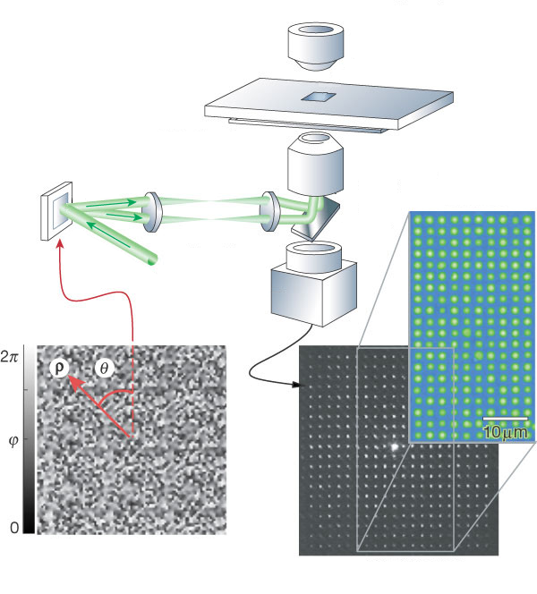
Illuminator
Sample volume
Diffraction grating
Objective Lens
Video camera
Laser beam
Wavefront phase
20×20 array optical traps

Slide 28
Results
The time taken in seconds to compute total force exerted on a single microparticle performed 5000 times
  GPU-based force calculation is about a 34 times faster
Method | Number of Rays
 | 8² | 16² | 32² | 64² | 128² | 256²
Ashkin (Float) | 0.08 | 0.36 | 1.27 | 5.05 | 20.28 | 81.74
Ashkin (Double) | 0.08 | 0.37 | 1.34 | 5.33 | 21.53 | 86.51
CPU Ray (Float) | 0.08 | 0.34 | 1.44 | 5.49 | 22.12 | 88.93
CPU Ray (Double) | 0.09 | 0.35 | 1.42 | 5.76 | 22.86 | 92.52
GPU NMF (Float) | 0.99 | 0.96 | 0.98 | 1.19 | 2.06 | 5.49
GPU Ray (Float) | 0.71 | 0.87 | 0.83 | 0.90 | 1.21 | 2.38
Notes:
We compare the timings of various methods: Ashkin’s traditional, CPU-based ray tracing, GPU-based method that uses NMF, and GPU-based ray tracing methods using single and double precision floating-point arithmetic.
For the first experiment, we perform force calculations on a single microparticle 5000 times placed in different locations around the focal point of the laser beam.
We also vary the number of rays that are used to describe the laser beam. As shown in Table 1, when only one microparticle and 256sq rays are used to represent the laser beam, the GPU-based force calculation is about a 34 times faster than Ashkin’s method.
CPU based ray-tracing method performs slightly slower than Ashkin’t traditional method because ray-tracing engine performs extra step which is checking if the transmitted ray intersects with any objects.

Slide 29
Results
The time taken in seconds to compute total force exerted on a single microparticle performed 5000 times without computing transmitted ray
Method | Number of Rays
 | 8² | 16² | 32² | 64² | 128² | 256²
Ashkin (Float) | 0.08 | 0.36 | 1.27 | 5.05 | 20.28 | 81.74
Ashkin (Double) | 0.08 | 0.37 | 1.34 | 5.33 | 21.53 | 86.51
CPU Ray (Float) | 0.07 | 0.26 | 1.04 | 4.16 | 16.62 | 67.40
CPU Ray (Double) | 0.08 | 0.31 | 1.24 | 4.95 | 19.90 | 80.80
GPU NMF (Float) | 0.92 | 0.90 | 0.93 | 1.13 | 1.99 | 4.94
GPU Ray (Float) | 0.70 | 0.81 | 0.83 | 0.88 | 1.13 | 2.23
Notes:
We compare the timings of various methods: Ashkin’s traditional, CPU-based ray tracing, GPU-based method that uses NMF, and GPU-based ray tracing methods using single and double precision floating-point arithmetic.
For the first experiment, we perform force calculations on a single microparticle 5000 times placed in different locations around the focal point of the laser beam.
We also vary the number of rays that are used to describe the laser beam. As shown in Table 1, when only one microparticle and 256sq rays are used to represent the laser beam, the GPU-based force calculation is about a 34 times faster than Ashkin’s method.
CPU based ray-tracing method performs slightly slower than Ashkin’t traditional method because ray-tracing engine performs extra step which is checking if the transmitted ray intersects with any objects.

Slide 30
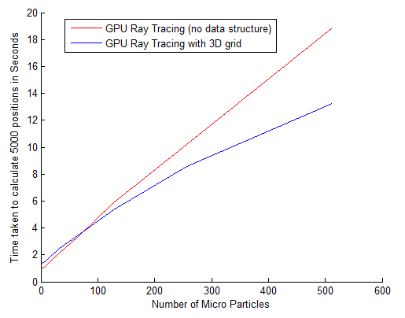
Results
The time taken to compute the force exerted by a laser beam containing 32 rays 5000 times.
As the number of particles increases, the use of a 3D grid data structure shows a clear advantage.
Notes:
When inspected carefully, using a 3D grid causes a slight delay when the numbers of rays or particles are low.
This is generally because of the overhead of creating, updating, and transferring the grid to the GPU.
When the numbers of rays or particles increases, the 3D grid performs better than the brute-force ray tracing method.
As the performance depends on the number of particles, we allow the user to select any desired method.

Slide 31
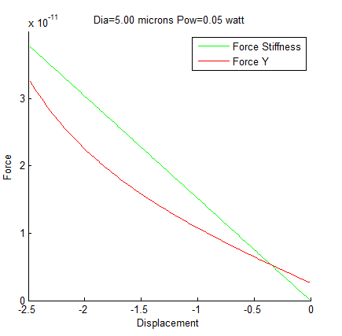

Results
Calibration and Validation
  Comparison against force computed using stiffness $F=−kd$ ($k$ is the stiffness and $d$ is the displacement)
  The stiffness value calibrated by Singer et al. is used
  Singer, W., Bernet, S., and Ritsch-Marte, M., 2001.“3D-force calibration of optical tweezers for mechanical
  stimulation of surfactant-releasing lung cells”.Laser physics, 11(11), pp. 1217–1223. eng.
Notes:
We have also compared and validated force calculated using our method against the force computed using stiffness $F=−kd$, where $k$ is the stiffness ($1.52e−05\frac{N}{m}$) and $d$ is the displacement distance between the center of the microparticle and the focal point of the laser.
Here, we use the stiffness value computed by Singer et al. for a microparticle of diameter $5 μm$ and the laser with power $0.05$ watts.
Here the focal point of the laser is located at the (0:0;0:0;0:0) and we compute force by placing the microparticle along the Y-axis.
We show the force computed by both methods when the microparticle is placed at various distances from the focal point. We have found the values to be comparable.
Although the force computed using stiffness is an approximation, we have compared and validated our result because the stiffness value computed by Singer et al. is calibrated.

Slide 32
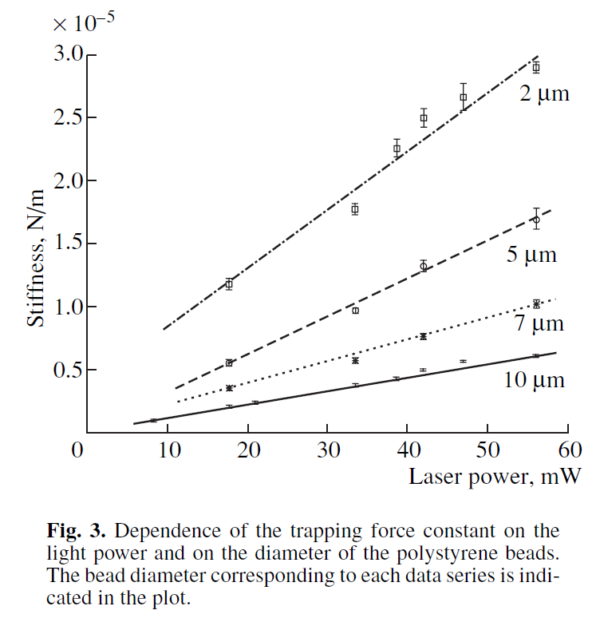
Stiffness plot
Back

Slide 33
System Info
Implemented using Visual C++ 2010 and CUDA API
Windows 7 64-bit machine
Intel I5-750 2.66 GHz processor
NVIDIA GeForce 470 GTX GPU
8GB of RAM

